Slide 1


Phishing Simulation
A Realistic Approach for Phishing Awareness
Research Interns:
K.Rithvik Reddy
G.Nishanth Reddy
V.Pranav
Bhavana Murthy
G.Sanjana
V.Nithin
B.Nikhil
Principal Investigator:
Mr. Tanyyala Sai Kumar

Slide 2
Agenda
Reasons for Emails to fall in Inbox or Spam
System Architecture
Phishing Email Creation
Email Depolyment and Tracking
Reinforce Learning Strategies

Slide 3
Recap
Email Delivery Optimization
Template Expansion and Augmentation
Few-Shot Learning with LLM
Advanced Email Analysis
Server Infrastructure Enhancements
Progress Update and Status

Slide 4
Reasons for Emails to fall in -
INBOX
SPAM
Strong Sender Reputation
Email providers track your sending history. A good reputation, based on low spam complaints and high engagement, signals trustworthiness.
Relevant and Engaging Content
Personalized, valuable content that recipients want to read encourages opens, clicks, and replies, boosting your sender reputation.
Clean Email List
Sending to valid, active addresses reduces bounces and spam traps, keeping your list healthy.
Positive User Engagement
Recipients who open, click, and interact with your emails signal to providers that your content is wanted, improving inbox placement.
Properly Formatted Emails
Avoid overly complex HTML or design elements that can trigger spam filters.
Spammy (Triggering) Words and Phrases
Words and phrases commonly used in spam emails (e.g., "free," "guaranteed," "limited time offer").
Excessive Formatting
Overuse of images, colors, and fonts can make your emails look suspicious.
HTML Errors
Poorly coded HTML can trigger spam filters.
Suspicious Attachments
Sending attachments from unknown senders is a red flag.

Slide 5
System Architecture
LLM Model
SMTP Server
User’s Mailbox
User Interaction
PhishSim360
Web Dashboard
Corpus
Manually crafted templates
Generates phishing templates
Sends phishing emails to targeted users
Receives phishing emails
Tracks the user data,
log clicks,
IP addresses
And learns about reinforce learning by phishing
Displays analysis reports to both admin and user

Slide 6
Advanced AI-Powered Phishing Email Creation
Manually crafted phishing templates of various categories which laid the foundation for our project.
By fine tuning the Large Language Models (LLMs) we generated various diverse, realistic variations of the email templates.
Fine-tuning on phishing email templates enhances accuracy and adaptability.
Few-shot prompting: Customizing emails for specific scenarios.
Sentiment analysis: Refining messages based on emotional triggers.

Slide 7
Realistic Email Deployment & Tracking
Uses an SMTP server for secure, large-scale email distribution.
Web-based interface allows administrators to launch phishing campaigns and monitor responses.
Secure database logs all user interactions such as link clicks, user IDs, and IP addresses.
Identifies high-risk individuals or departments.

Slide 8
Transforming Interactions into Learning Opportunities
Immediate feedback for users clicking phishing links.
Reinforce Learning By Actions:
1. Inspect the Link – Check for spelling errors and unusual subdomains.
2. Use Online Link Checkers – URLScan.io, VirusTotal, Google Safe Browsing.
3. Check Website Certificates – Verify SSL certificates.
4. Verify with the Sender – Contact them separately.
5. Report Phishing – Notify IT or cybersecurity organizations.
Additionally, we also provided few phishing statistics through which we provide awareness to the users about phishing and its threats.

Slide 9
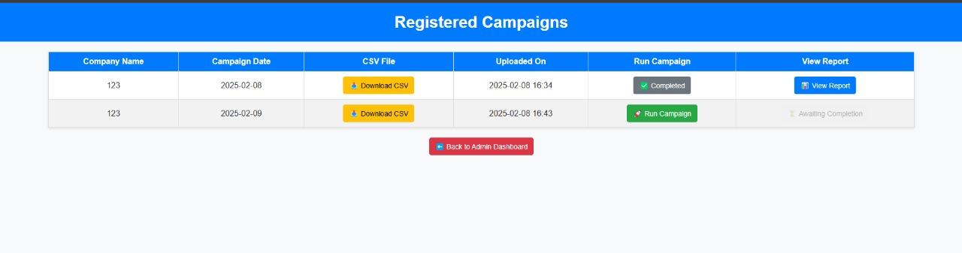
Campaign will be run by admin

Slide 10
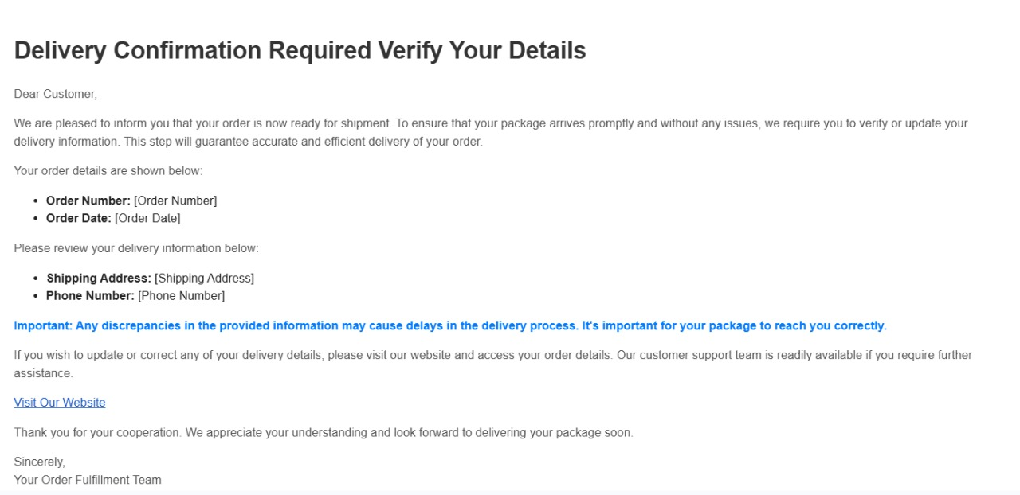
Sample Email Template:

Slide 11
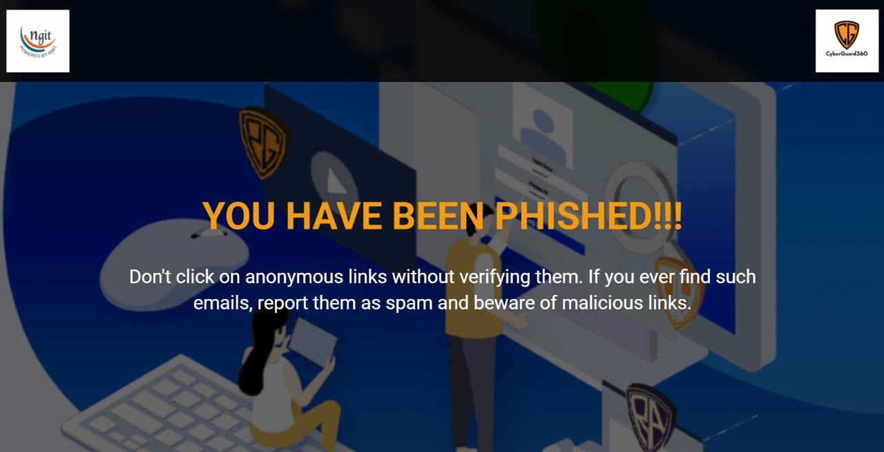

Slide 12
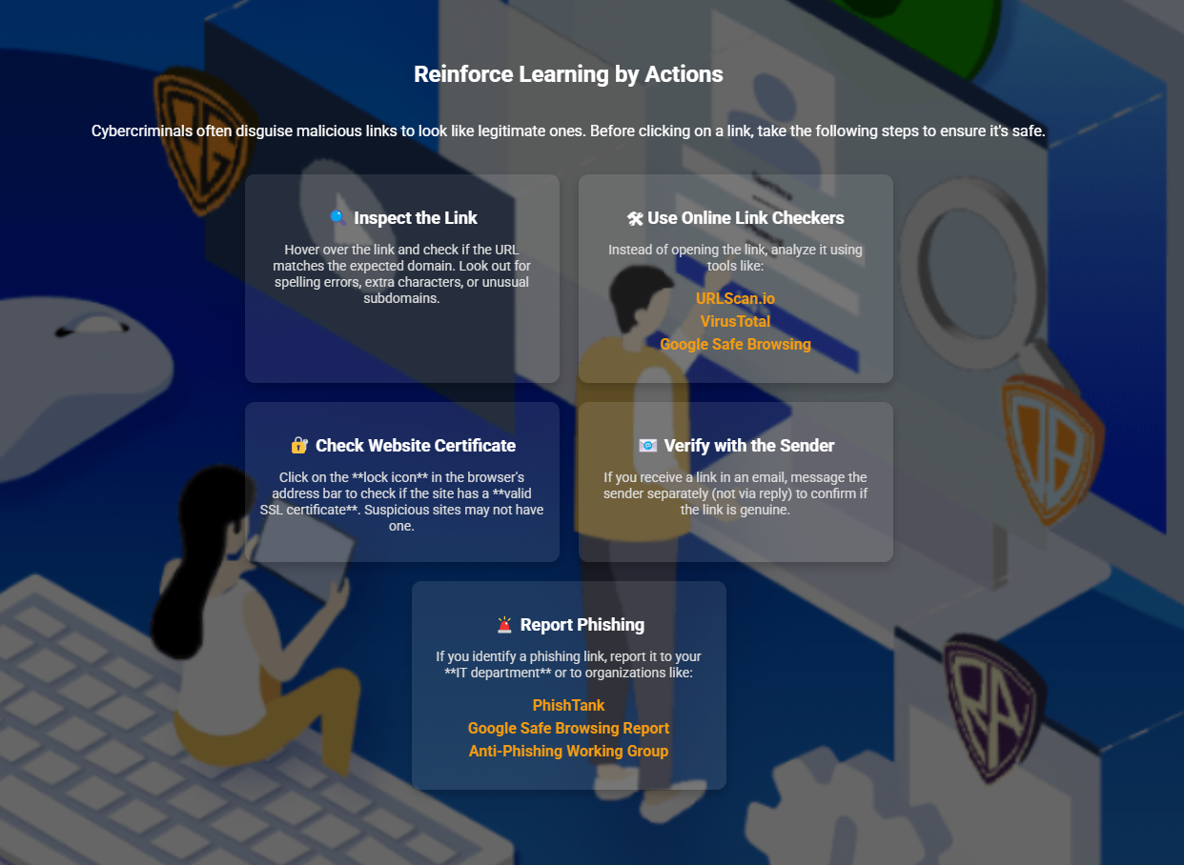

Slide 13
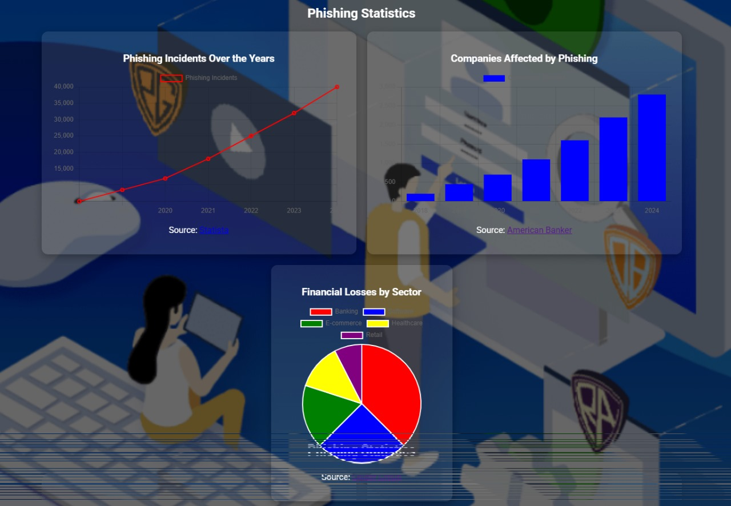

User logs of those who fall for phishing simulation

